Slide 1
WELCOME
LangGo – Name of class

Slide 2
Classroom rules
1.Be on time
2.Be interactive
3.100% or Nothing
4.Do all Daily Challenges

Slide 3
Review
Các cụm từ đi với GET và GO học được từ DC:
- Go shopping
Get some exercise
Get a job
Get up
Get back from
Get a taxi
Get a doctor
Get some coffee
Get sick
Get married
Go swimming
Go on
Go fishing
Go sightseeing
-
-
-
-
-
-
Run out of
The top of the hill
Go up
Wet
Stair (downstairs/upstairs)
Aware
Motorbike
I go to school on foot

Slide 4

Lesson 3: Consonants

Slide 5
Objectives
  Review diphthongs
1
  14 consonants
2

Slide 6
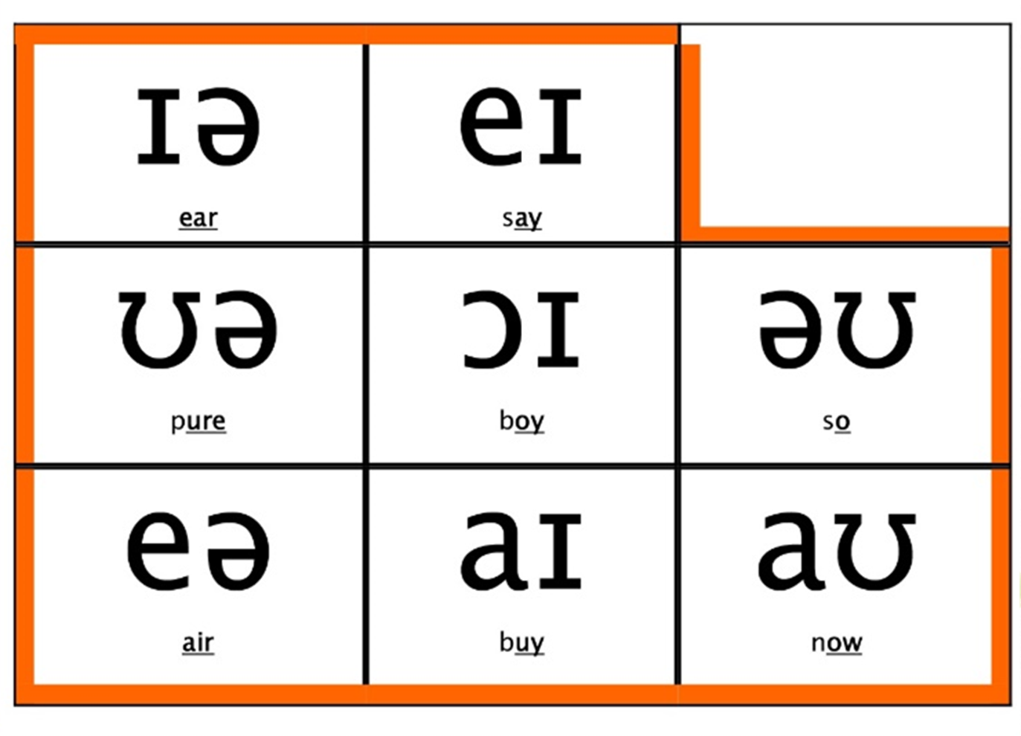

Slide 7
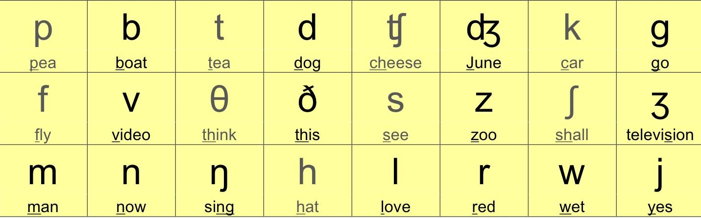
CONSONANTS

Slide 8
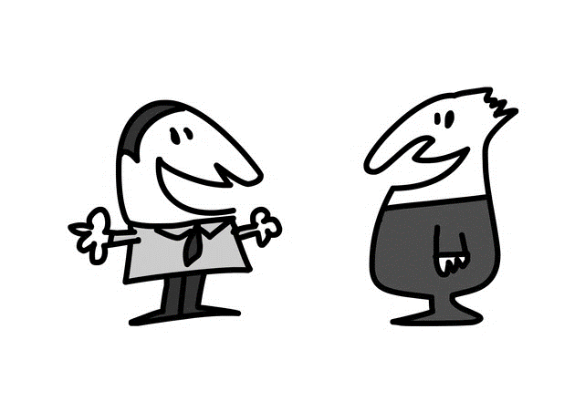
Sounds
/p/
/b/

Slide 9
Sound /p/
p | pp
pen /pen/ put /put/ stop /stɒp/ | happy /ˈhæp.i/ stopping /ˈstɒp.ɪŋ/
Notes:
Môi mím chặt sau đó mở nhanh, bật hơi mạnh

Slide 10
Sound /b/
b | bb
big /bɪɡ/ best /best/ tab /tæb/ | robber /ˈrɒb.ər/

Slide 11
Sounds
/t/
/d/

Slide 12
Sound /t/
t | tt
tea /tiː/ ten /ten/ two /tu:/ water /ˈwɔː.tər/ eat /iːt/ light /laɪt/ | better /ˈbet.ər/ bottle /ˈbɒt.əl/
Notes:
2 hàm răng khép – đầu lưỡi sau chân răng cửa hàm trên – lưỡi hạ xuống nhanh

Slide 13
Sound /d/
d | dd
day /deɪ/ do /duː/ door /dɔːr/ did /dɪd/ food /fuːd/ ready /ˈred.i/ | add /æd/ address /əˈdres/ ladder /ˈlæd.ər/ middle /ˈmɪd.əl/

Slide 14
Sounds
/k/
/ɡ/

Slide 15
Sound /k/
c | k | ck | ch
car /kɑːr/ careful /ˈkeə.fəl/ cat /kæt/ clean /kliːn/ | key /kiː/ kitchen /ˈkɪtʃ.ən/ walk /wɔːk/ talk /tɔːk/ | back /bæk/ check /tʃek/ tick /tɪk/ | school /skuːl/ stomach /ˈstʌm.ək/ chemist /ˈkem.ɪst/
Notes:
Cuống lưỡi về ngạc mềm, hạ cuống lưỡi xuống nhanh

Slide 16
Sound /g/
g | gg
garden /ˈɡɑː.dən/ go /ɡəʊ/ ago /əˈɡəʊ/ hungry /ˈhʌŋ.ɡri/ bag /bæɡ/ | egg /eɡ/ bigger /'bɪɡ.ər/

Slide 17
Exercise: Read these sentences
I had a stomach ache two days ago. I decided to go to the chemist's. Then, I walked to the market to buy a bag of eggs for dinner because I was hungry. | /aɪ hæd ə ˈstʌmək eɪk tu: deɪz əˈɡoʊ/ /aɪ dɪˈsaɪdɪd tə ɡoʊ tə ðə ˈkemɪsts/ /ðen, aɪ wɔ:kt tu ðə ˈmɑrkɪt tə baɪ ə bæɡ əv eɡz fɔr ˈdɪnər bɪˈkɔz aɪ wəz ˈhʌŋɡri/
Notes:
Student’s book Ex.F page 17

Slide 19
Sounds
/f/
/v/

Slide 20
Sound /f/
f | ff | ph | gh
fork /fɔːk/ fast /fɑːst/ floor /flɔːr/ few /fjuː/ lift /lɪft/ | off /ɒf/ coffee /ˈkɒf.i/ | phone /fəʊn/ autograph /ˈɔː.tə.ɡrɑːf/ | laugh /lɑːf/ cough /kɒf/

Slide 21
Sound /v/
v
very /ˈver.i/ seven /ˈsev.ən/ drive /draɪv/ view /vjuː/ | knives /naɪvz/ river /ˈrɪv.ər/ voice /vɔɪs/ vegetable /ˈvedʒ.tə.bəl/

Slide 22
Sounds
/s/
/z/

Slide 23
Sound /s/
s | ss | c | sc
sit /sɪt/ sister /ˈsɪs.tər/ bus /bʌs/ stop /stɒp/ | class /klɑːs/ glasses /'ɡlɑːs.ɪz/ | city /ˈsɪt.i/ circle /ˈsɜː.kəl/ pencil /ˈpen.səl/ | science /ˈsaɪ.əns/ scissors /ˈsɪz.əz/
Notes:
Hàm răng khép, đầu lưỡi ở chân răng cửa hàm dưới

Slide 24
Sound /z/
s | z | ss | zz
easy /ˈiː.zi/ husband /ˈhʌz.bənd/ roses /ˈrəʊz.ɪz/ | zoo /zuː/ zero /ˈzɪə.rəʊ/ size /saɪz/ | scissors /ˈsɪz.əz/ | jazz /dʒæz/

Slide 25
Exercise 6: Read the poem.
Mondays to Fridays - Gets up. Walks to the station. Waits for the train. Gets off at the fourth stop. Walks to the office. Sits in the office. | Has lunch. Sits in the office. Walks to the station. Comes home. Thinks: “One day …”
Notes:
Student’s book Ex.K page 19

Slide 26
Sounds
/ʃ/
/ȝ/

Slide 27
Sound /ʃ/
sh | c/ch | ci/ti | s/ss
​cash /kæʃ/ shop /ʃɒp/ fashion /ˈfæʃ.ən/ | ocean /ˈəʊ.ʃən/ machine /məˈʃiːn/ chef /ʃef/ | delicious /dɪˈlɪʃ.əs/ special /ˈspeʃ.əl/ international /ˌɪn.təˈnæʃ.ən.əl/ | sugar /ˈʃʊɡ.ər/ sure /ʃʊr/ Russia /ˈrʌʃ.ə/
Notes:
Môi tròn, hàm răng khép, lưỡi gần tiếp xúc vòm họng

Slide 28
Sound /ʃ/
Shake Sure Short Shirts | /ʃeɪk/ /ʃʊə(r)/ /ʃɔːrt/ /ʃɜːrts/ | Push English Finish Washing machine | /pʊʃ/ /ˈɪŋɡlɪʃ/ /ˈfɪnɪʃ/ /ˈwɒʃɪŋ məˈʃiːn/

Slide 29

Sound /ʒ/
Measure | Treasure | Leisure
/ˈmeʒə(r)/ | /ˈtreʒə(r)/ | /ˈliːʒə(r)/
Collision | Television | Asia
/kəˈlɪʒn/ | /ˈtelɪvɪʒn/ | /ˈeɪʒə/
Casual | Garage | Decision
/ˈkæʒuəl/ | /ɡəˈrɑːʒ/ | /dɪˈsɪʒn/

Slide 30
Sounds
/tʃ/
/dȝ/

Slide 31
Sound /tʃ/
ch | t | tch
teacher /ˈtiː.tʃər/ chair /tʃeər/ chicken /ˈtʃɪk.ɪn/ cheap /tʃiːp/ | future /ˈfjuː.tʃər/ question /ˈkwes.tʃən/ | catch /kætʃ/ watch /wɒtʃ/ kitchen /ˈkɪtʃ.ən/ Dutch /dʌtʃ/
Notes:
Hàm răng khép hờ, đầu lưỡi ở chân răng cửa hàm trên, môi tròn, đầu lưỡi hạ xuống

Slide 32
Sound /dʒ/
j | g | ge | dge
jam /dʒæm/ jacket /ˈdʒæk.ɪt/ juice /dʒuːs/ | general /ˈdʒen.ər.əl/ dangerous /ˈdeɪn.dʒər.əs/ | language /ˈlæŋ.ɡwɪdʒ/ large /lɑːdʒ/ lounge /laʊndʒ/ orange /ˈɒr.ɪndʒ/ | fridge /frɪdʒ/ bridge /brɪdʒ/

Slide 33

/ʃ/
/ȝ/
/dȝ/
/tʃ/
Notes:
Practice: Read the words in the handout

Slide 34
JUICE
/dʒuːs/

Slide 35
PICTURE
/ˈpɪk.tʃɚ/

Slide 36
ENGLISH
/ˈɪŋ.ɡlɪʃ/

Slide 37
VISION
/ˈvɪʒ.ən/

Slide 38
KITCHEN
/ˈkɪtʃ.ən/

Slide 39
CASH
/kæʃ/

Slide 40
Read these sentences
She woke up early on Saturday morning to catch the bus to the city.
/ʃiː wəʊk ʌp ˈɜːli ɒn ˈsætədeɪ ˈmɔːnɪŋ tuː kætʃ ðə bʌs tuː ðə ˈsɪti./
She needed to buy groceries and meet a friend for lunch.
/ʃiː ˈniːdɪd tuː baɪ ˈɡrəʊsəriz ænd miːt ə frend fɔːr lʌntʃ./
After shopping, they had a delicious meal at a cozy café.
/ˈɑːftər ˈʃɒpɪŋ, ðeɪ hæd ə dɪˈlɪʃəs miːl æt ə ˈkəʊzi kæˈfeɪ./
She enjoyed her day exploring new places and meeting new people.
/ʃiː ɪnˈdʒɔɪd hə deɪ ɪkˈsplɔːrɪŋ njuː ˈpleɪsɪz ænd ˈmiːtɪŋ njuː ˈpiːpl./

Slide 41
THANKS!

